Slide 1
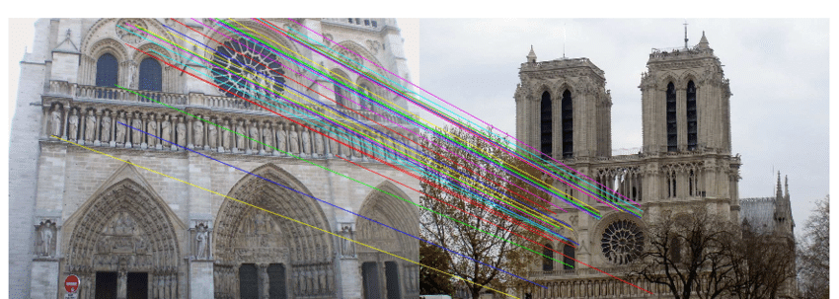
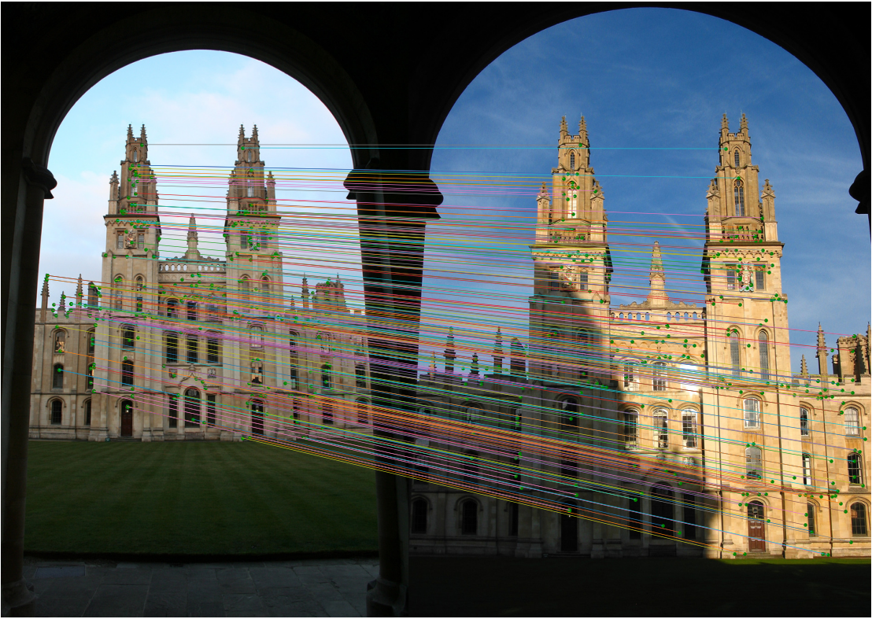

Combining Harris Interest Points and the SIFT Descriptor for Fast Scale-Invariant Object Recognition

Slide 2
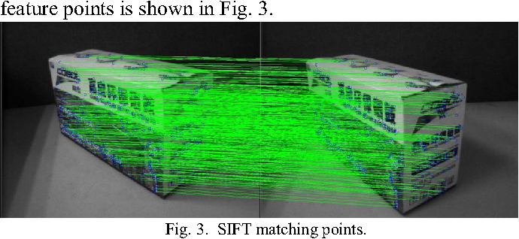
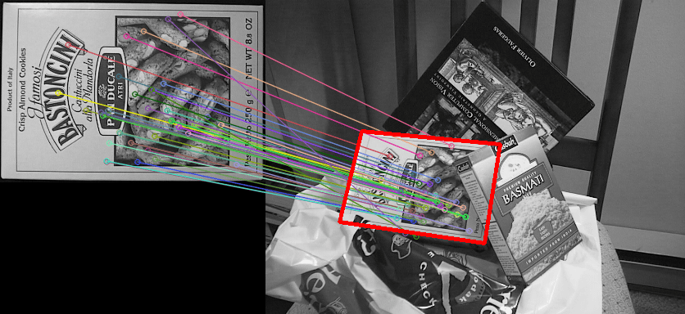

Introduction/Motivation
Object recognition: classification, tagging, detection and segmentation
Scale-invariant feature transform (SIFT):
keypoints invariant to location, scale, rotation, illumination and robust to affine transformation
SIFT features
SIFT applications in object recognition:
Identifying matching locations between images
Recognizing objects in 2D
3D reconstruction
Image stitching…
3D reconstruction based on SIFT and Harris feature points
Object recognition using SIFT

Slide 3
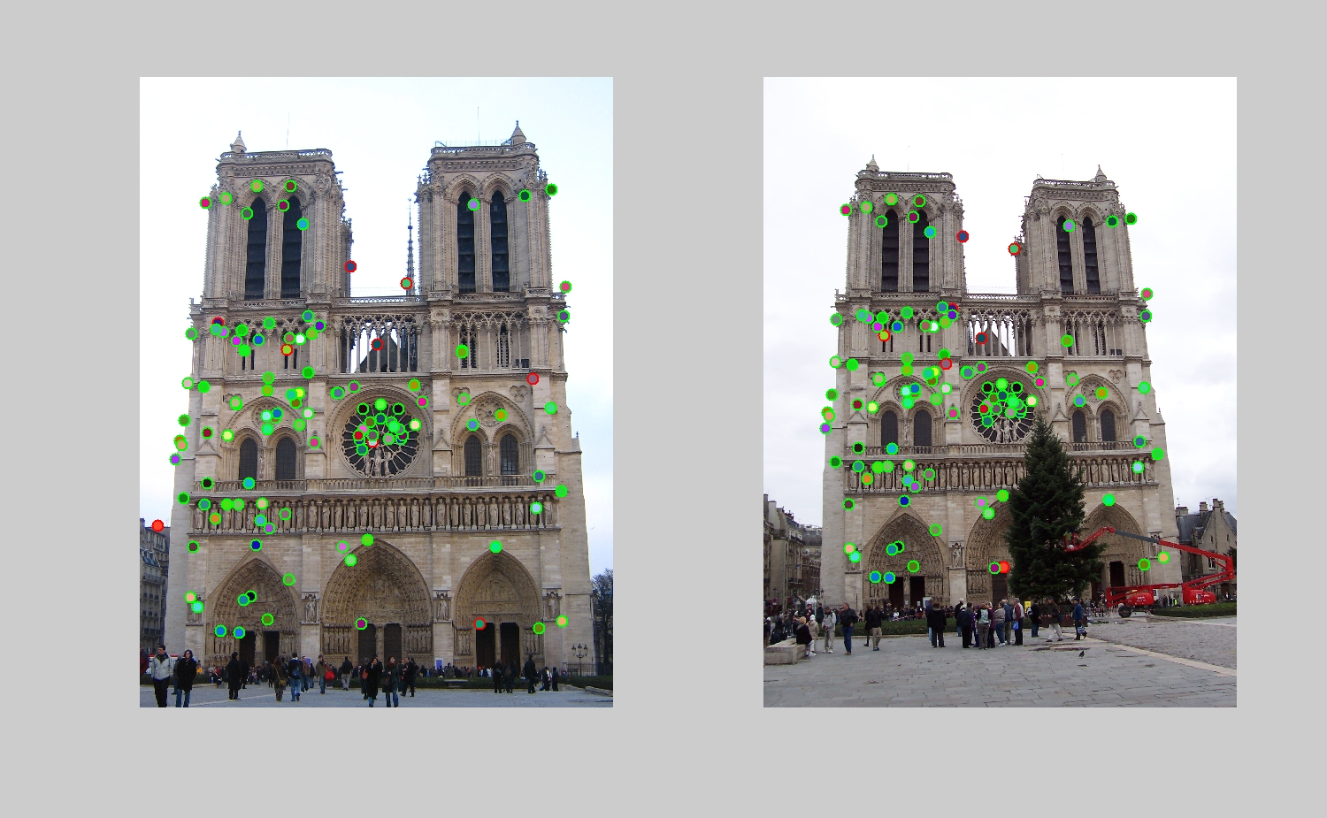
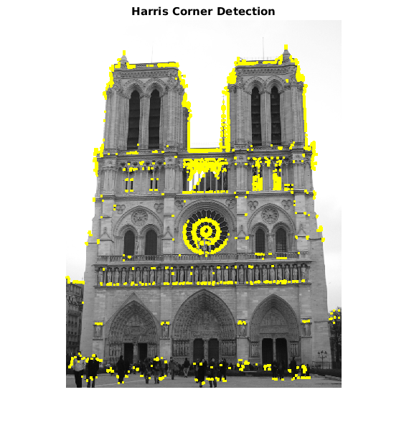

Problem Definition
Scale Space Analysis of SIFT is too slow when it comes to time-critical applications of object recognition and localization systems that depend on SIFT features.
Our Project
New object recognition method combining SIFT and Harris to achieve a lower computational time while preserving scale-invariance
+
=
SIFT Features
Harris Corner Detector

Slide 4

Related Work
The comparison between SIFT/Harris have already been conducted in previous works [1]
According to [1], SIFT is way more precise than Harris
However, Harris is way faster than SIFT ➔ more interesting for time-critical applications
[2] also shows some tricks to make Harris scale invariant

Slide 5
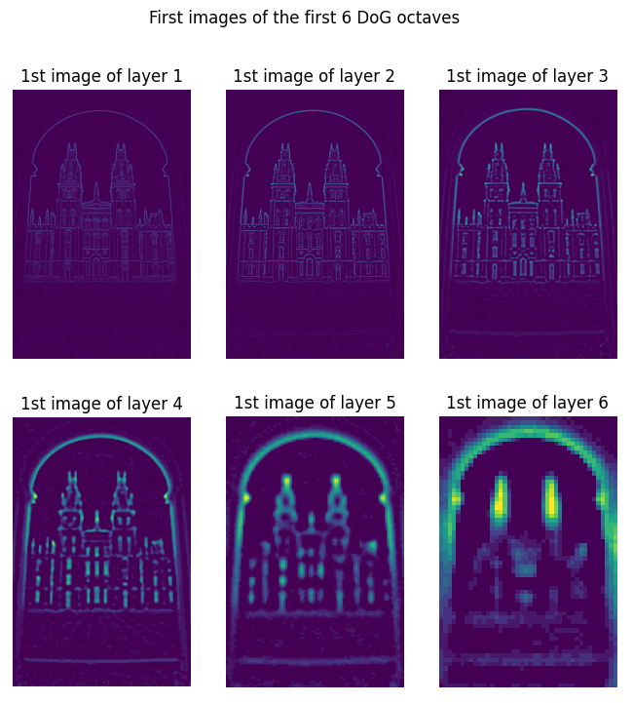
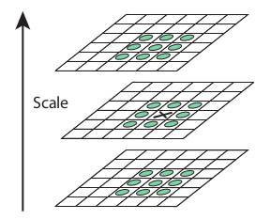

Methodology: SIFT Implementation
Step 1: Scale-Space Extrema Detection | Step 2: Keypoint Localization
Building Difference of Gaussians (DoG) octaves: The blur of the last image of an octave is twice the blur of the first image Resize last image so that it becomes the first image of the next octave. Initialize keypoints | Find the accurate keypoints of the image: Eliminate keypoints of low contrast Eliminate edge responses

Slide 6
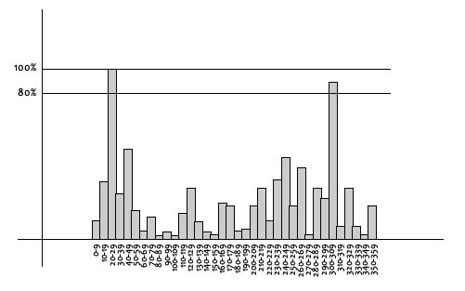
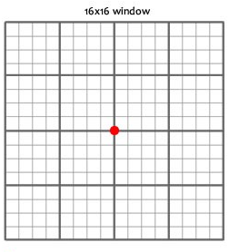
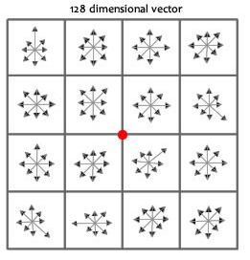

Methodology: SIFT Implementation
Step 3: Orientation Assignement | Step 4: Local Descriptor Creation
Assign an orientation to ensure rotational invariance: Take a neighborhood around a keypoint depending on the scale. Build orientation histogram. Add new keypoints if the magnitude of a bin is higher than 80% of the highest bin. | Find the SIFT descriptors: Take a 16x16 window around each keypoint and divide it into 16 sub-blocks of size 4x4. Build 8 bin orientation histogram for each subregion. We obtain a 4x4x8=128 feature vector vector

Slide 7
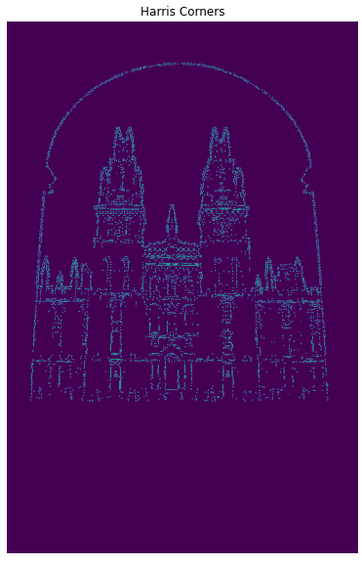

1- Combining SIFT and Harris

Slide 8

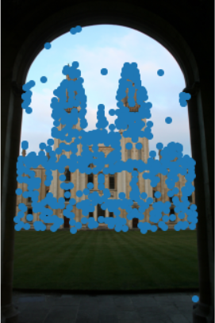

2- Bilateral Filter before computing keypoints
Compute keypoints combining SIFT + Harris
Apply bilateral filter to the image

Slide 9
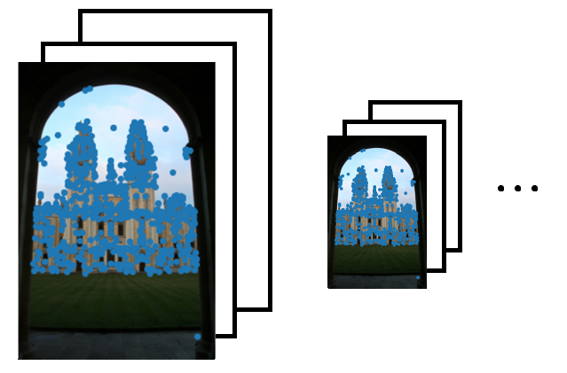
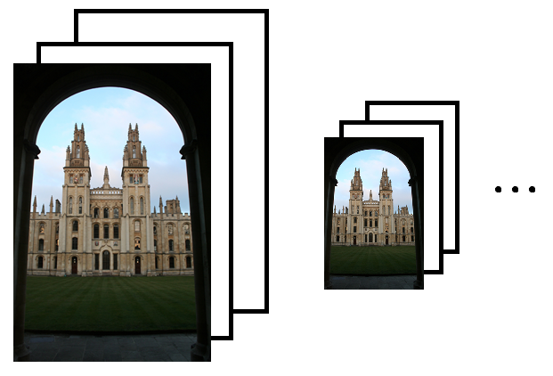

3- Harris/SIFT and use only first layer per octave
Use only first layer per octave to compute Harris keypoints, ignore the other layers
Compute all layers of all octaves
Other layers will only be used to compute the descriptors of first layer keypoints

Slide 10
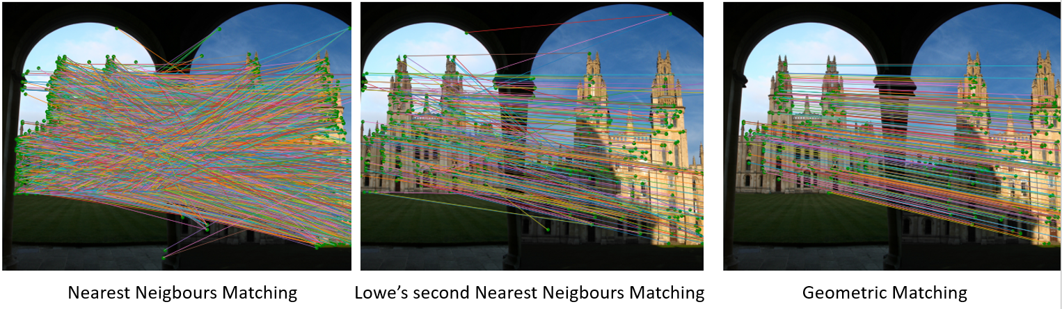

Results: Matching

Slide 11
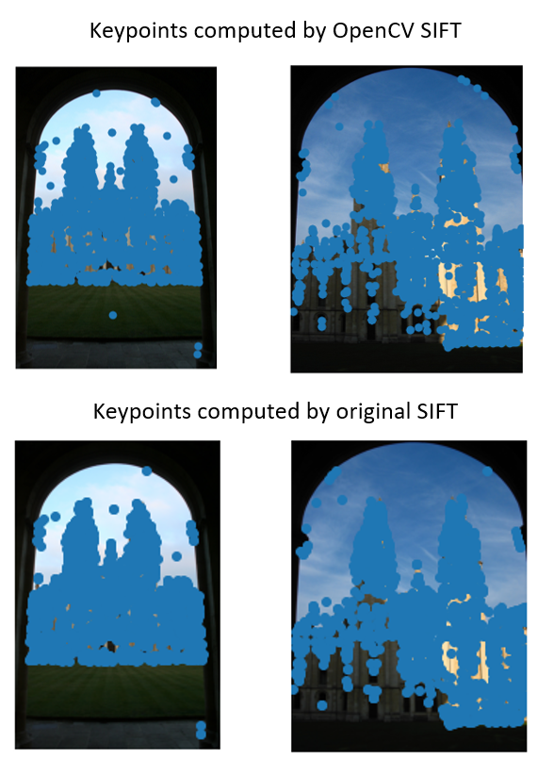
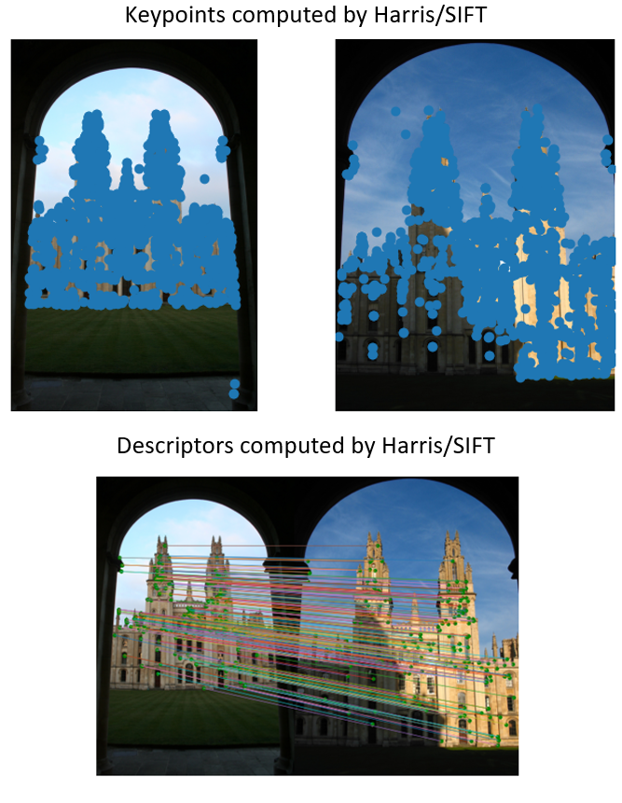
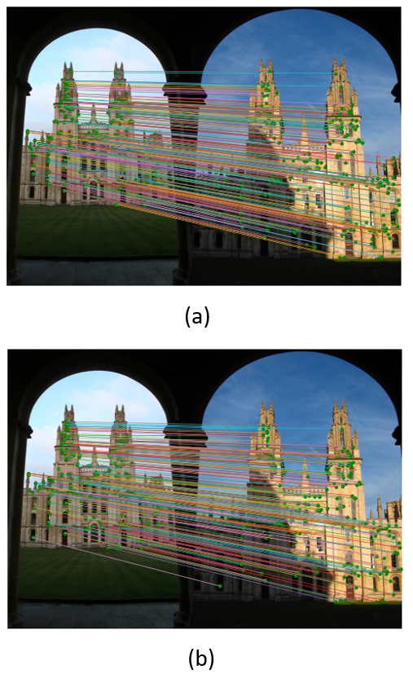
Results: 1- Combination SIFT/Harris Implementation
Keypoints computed with the implemented SIFT
Keypoints computed with SIFT/Harris
Descriptors computed with the implemented SIFT
Descriptors computed with SIFT/Harris

Slide 12
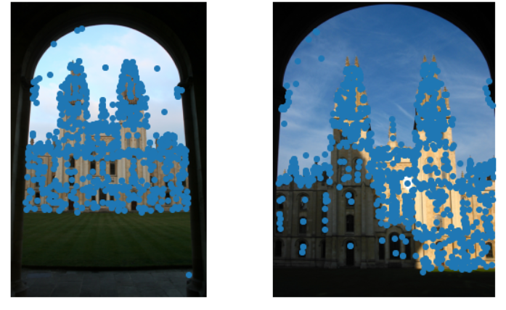
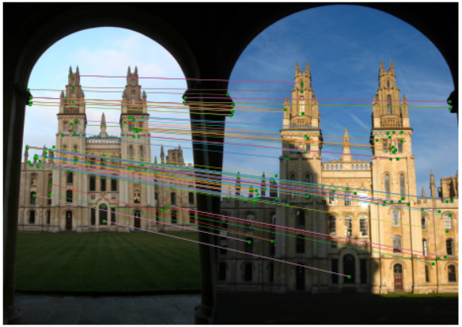
Results: 2- Bilateral Filter before computing keypoints
Computed keypoints with this method
Result of matching with this method

Slide 13
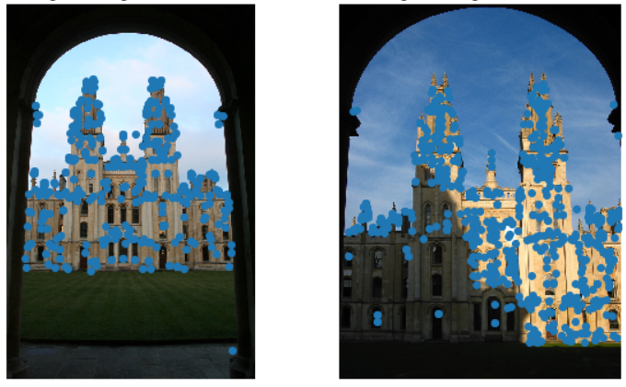
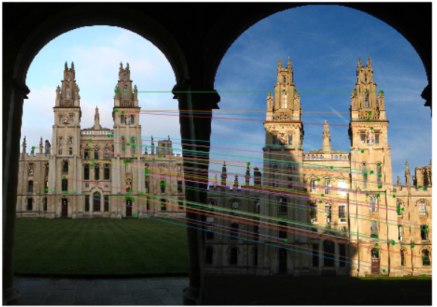
Results: 3- Harris/SIFT and use only first layer per octave
Computed keypoints with this method
Result of matching with this method

Slide 14
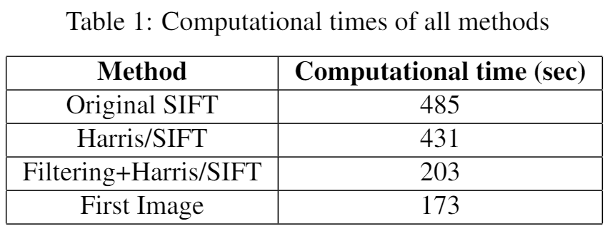
Computational time

Slide 15
Conclusion
Many ways to compute efficient keypoints with reduced computation time
Fewer time, but also fewer keypoints…
SIFT still the best in terms of matching images

Slide 16

References
[1] My-Ha Le, Byung-Seok Woo, Kang-Hyun JoAComparison of SIFT and Harris Conner Features forCorrespondence Points Matching
[2] Pedram Azad, Tamim Asfour, Rudiger DillmannCom-bining Harris Interest Points and the SIFT Descriptorfor Fast Scale-Invariant Object Recognition. Institutefor Anthropomatics, University of Karlsruhe, Germany,2009

